Slide 1
Discussions: Let’s Discuss
Praneet Tiwari & Vallari Chandna
Austin E. Cofrin School of Business
Virtual Instructional Development Institute 2021

Slide 2
Agenda
Overview of Discussions (15 mins)
Discussion on Discussions (5-10 mins)

Slide 3
Utility?
A way to “humanize” online learning.
Create a social presence in an online course along with a sense of community.
Can improve student learning and lead to increased satisfaction with the course.
Can help students who might feel overwhelmed by the online format as they see they are not alone but are in it together.
Provides a collaborative learning experience that promotes deeper understanding and learning.
Asynchronous online discussions lead to wider participation.
Asynchronous online discussions allow students time to think before responding and to edit their responses before sharing them with others.

Slide 4
Main Uses
Assignments Teamwork Community Informational

Slide 5
Use: Assignments
Students post their responses to the prompt. Other students read and reply to them with the aim being that students learn from each other.
These are often “threaded discussions”. These are where the instructor/leader posts one or multiple questions and participants reply to the question as well as each other’s posts as continuous “thread”.
Some types of discussion assignments:
Question and Answer: Question is posted, students are asked to respond to it and other students’ responses. Word limits and other instructions can be provided.
Assignment with a “peer review”: Students post their assignments before they can see others’ assignments. They provide feedback to each other following a rubric or outline.
Writing Emphasis Course Assignment: A detailed prompt is provided with a higher word limit and where responses are likely to vary. Instructor does need to provided detailed feedback on writing quality. If the feedback is provided as a response-post , other students can see that as well and reflect on it.

Slide 6
Use: Teamwork
If you use team assignments or projects in your course, you could create discussion spaces where team members can conduct their own team discussions without other teams “spying” on them
Canvas allows you to create almost a “course-within-a-course” with their own discussion space, announcement board, file sharing space etc.
You can also use it for smaller group discussions if you have a larger class

Slide 7
Use: Community
Online courses can have issues when it comes to engagement and community. Allowing some “casual” spaces could help with that.
Some types of community-focused discussion boards options:
Introductory discussions: These can be used in week 1 for students to “meet” each other and the instructor. Prompts can be provided e.g. Please provide your name, preferred pronouns, majors, something interesting about you. You could then provide your own response as a sample and also to get the ball-rolling.
Sharing space/Water-cooler : Students can just ask questions or share materials with each other.

Slide 8
Use: Informational
Discussion boards can also just be for sharing resources or information with the option to post additional clarification questions/ comments in the replies.
Some types of informational discussion boards options:
Ask your instructor or Ask each other spaces: These can be for students to ask questions that concern them about the course or a specific assignment. Students can often help each other resolve questions, but then instructors can answer anything that remains.
FAQs: Whether the “ask…” formats are used or not, it’s good to summarize the various issues that come up via the discussion boards or emails, under an FAQs space where responses can be enabled so that you can respond to “follow-up” questions. The same FAQs can be reposted in subsequent semesters if the assignments/materials are the same.

Slide 9
Options/Tools
Canvas- text
Canvas- VoiceThread
Piazza

Slide 10
Canvas: Basic
Standard discussions are embedded into Canvas already
Can be graded/ ungraded; threaded; “likes” allowed
Open to full class or groups
Allows file attachments, posting links, embedded images

Slide 11
Canvas: Voicethread
Integrated with Canvas - allows users to create presentations, post comments, and share content.
Allows you to place collections of media like images, videos, documents, and presentations at the center of an asynchronous conversation.
Make comments using any mix of text, a microphone, a webcam, a telephone, or uploaded audio file.
Quick video about Voicethread

Slide 12
Piazza
Currently a free tool
Questions and posts needing immediate action are highlighted
Instructors endorse answers to keep the class on track
Anonymous posting encourages every student to participate
Highly customizable online polls
Integrates with every major LMS
Additional useful features: Wiki style format; math/code/syntax easily added
View a “real class”

Slide 13
Some practical tips and helpful hints-1
If you plan on using them often, “introduce” them to students early so they can get comfortable with the format.
Ask open-ended questions- if only 1 answer is possible it won’t really lead to a conversation
Consider different response types: video submissions, news reports, Powerpoint/Slide deck submissions (Voicethread is very useful for multimedia discussions)

Slide 14
Some practical tips and helpful hint-2
Student leaders can be used if appropriate for your class (works well in graduate classes- they can “design” question and seek approval before posting)
Specify how many responses are needed (2-3 is good) and word limit if appropriate

Slide 15
Some practical tips and helpful hints-3
Specify deadlines for original answer and response posts
Remind students about “netiquette” and provide a document early on.

Slide 16
Some practical tips and helpful hints-4
Consider using it for students to provide feedback to each other as well
This can be on drafts of assignments that will be submitted to instructor or on assignments themselves ( as additional feedback)
Provide either a rubric or prompt for feedback.
An easy prompt is from the 3CQ model: “Use any 3 of these to provide feedback to your peers…
Compliment — I like that …
Comment — I agree with that, I disagree because …
Connection — I also thought …
Question — I wonder why …”

Slide 17
Some practical tips and helpful hints-5 “fun” introduction discussion assignments
Ask that they share something uninteresting about themselves (a twist on the classic)
Ask that they introduce themselves using only emojis. (Students then have to guess what each other's emoji chains mean.)
Ask for video introductions
Ask students to share a picture with their introduction- can be of them doing a fun activity or something meaningful to them
Ask students to share something related to course content (e.g. for a leadership class, you can ask students to find a good movie speech to share which can then be discussed later in the semester)

Slide 18
Some practical tips and helpful hints-6 Using discussions with F2F classes
Can be used for hybrid and F2F classes as well
Ask students to submit their “minute” papers on a discussion board right after a class. This way they can see each others’ work and reflect on it
Can be used for collaborative note taking
Use in addition to class discussions as many introverted students may be more comfortable in this format.

Slide 19
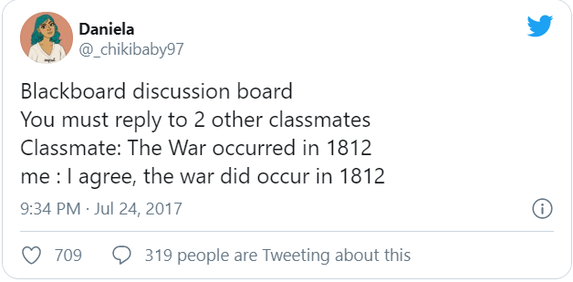
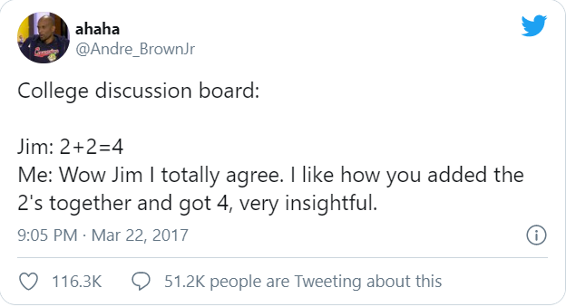

Slide 20
Google doc to brainstorm
https://docs.google.com/spreadsheets/d/1oLSAiof85-z4aKKYWoLzfEF3li4fOTndYN5CVNYXgn8/edit?usp=sharing

Slide 21
Additional Resources
Online Discussion Worksheet
Detailed Piazza info
General info on Discussion Boards
Collaborative note-taking
10 tips for effective discussions

Slide 22
And don’t forget – we have a Canvas board for you to leave comments on…

